Slide 1
Project 2
Aruzhan Symbatkyzy
Adil pushpakov

Slide 2
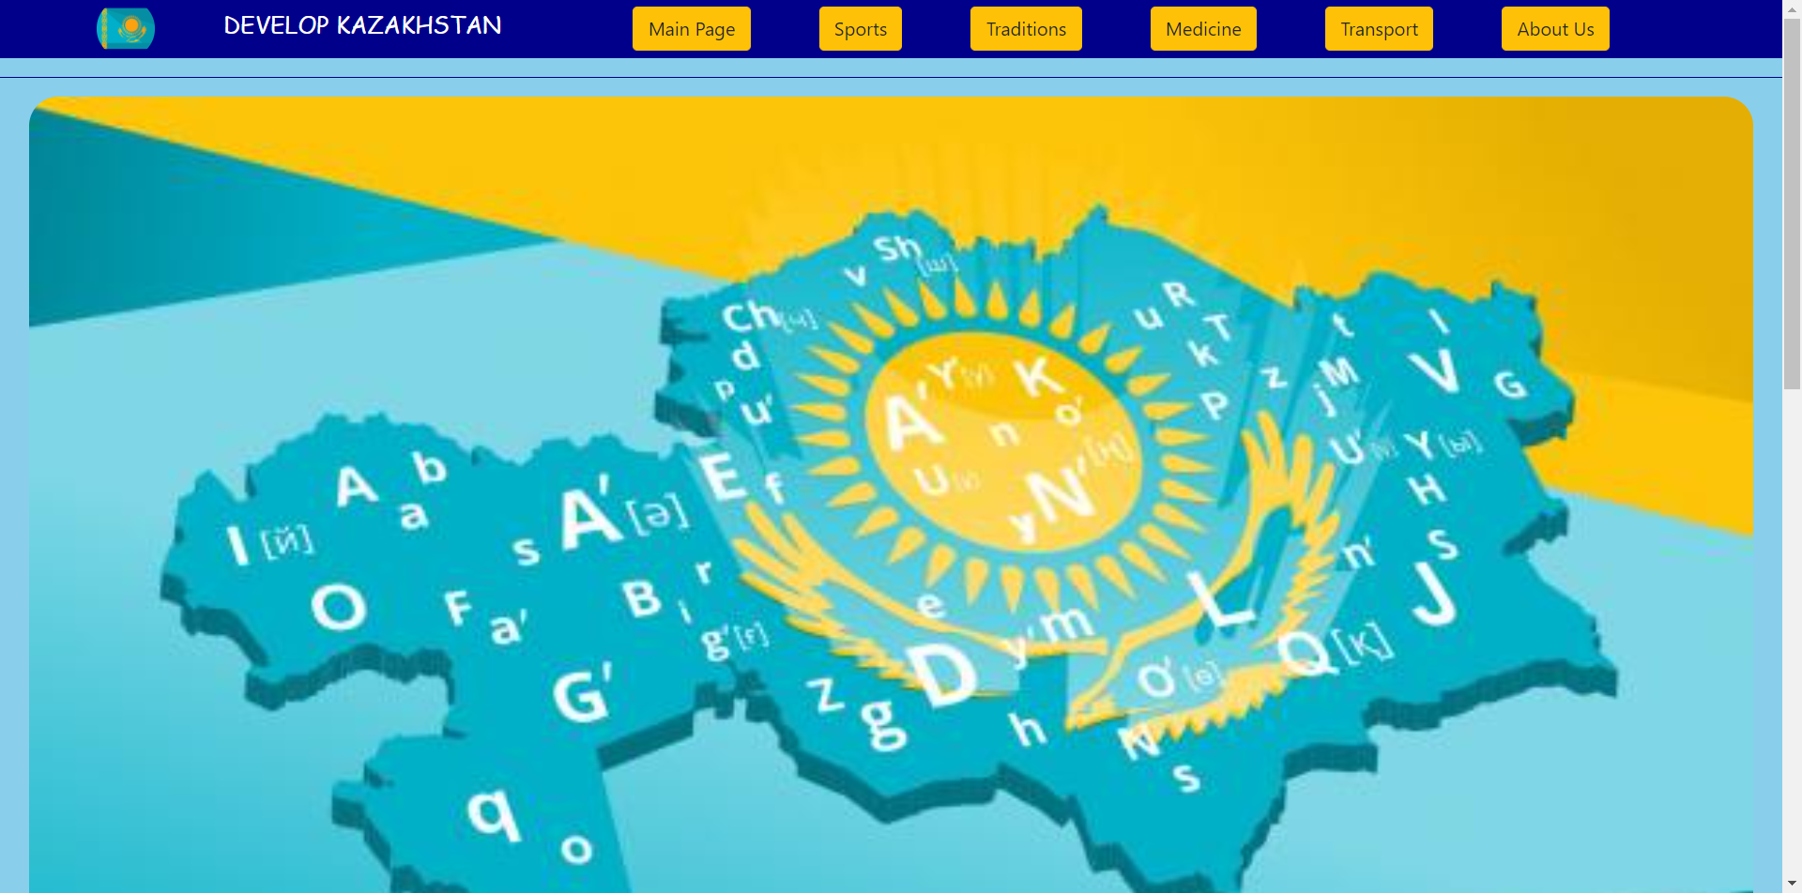

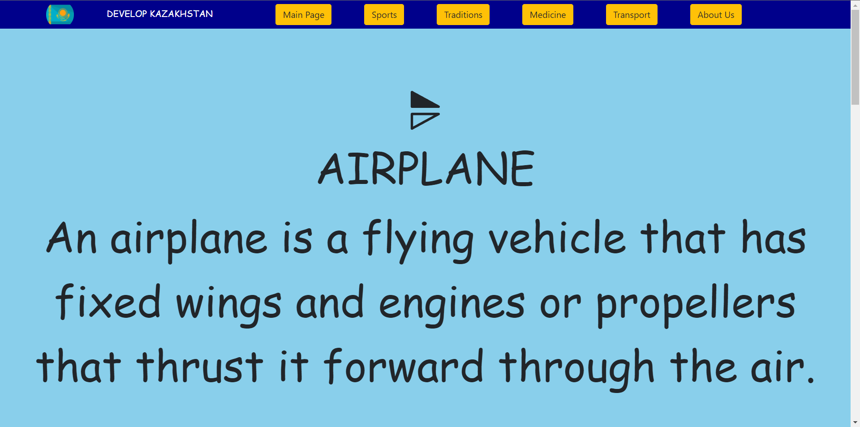

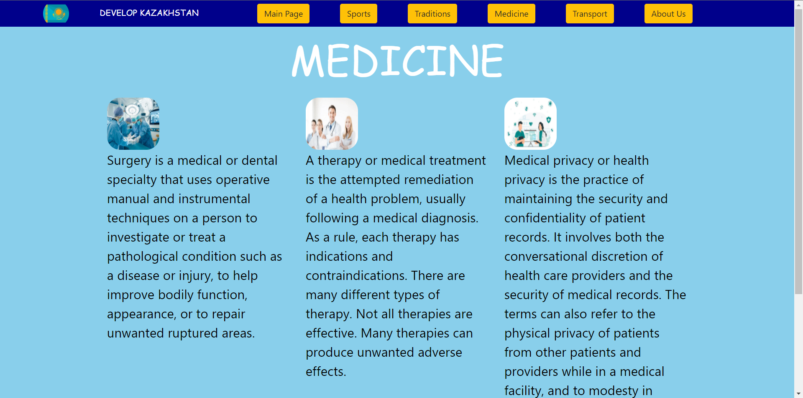
1)Number of web pages must be at least 5.

Slide 3
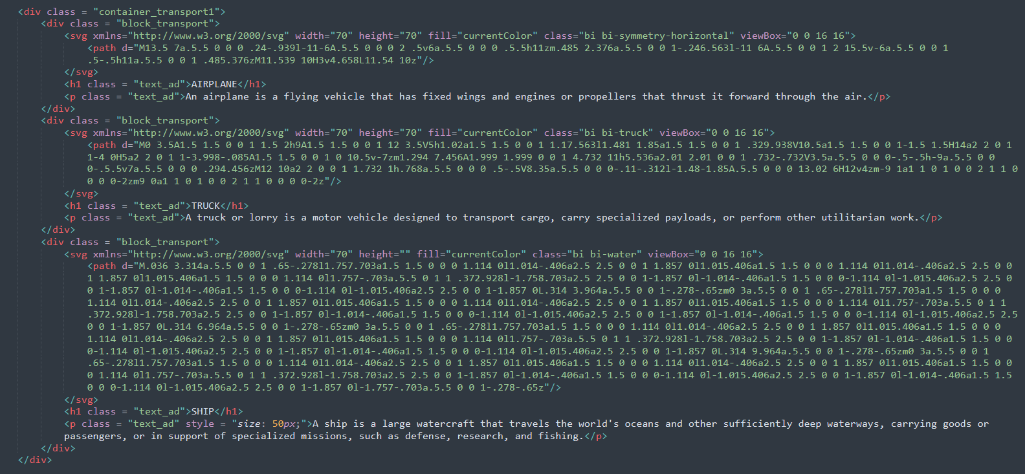
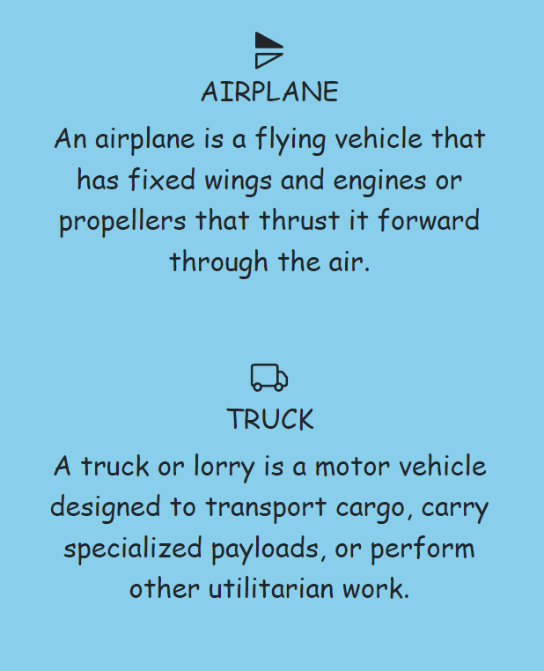
2)The project must contain at least two flexbox containers with elements.

Slide 4
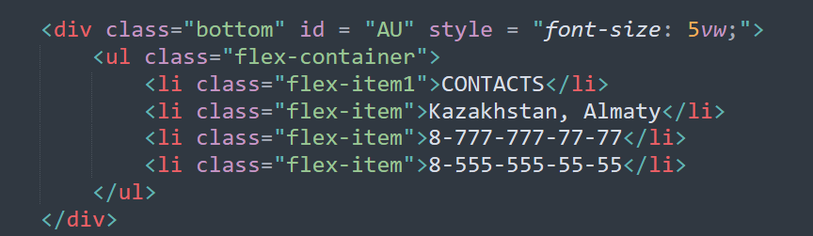

2)The project must contain at least two flexbox containers with elements.

Slide 5
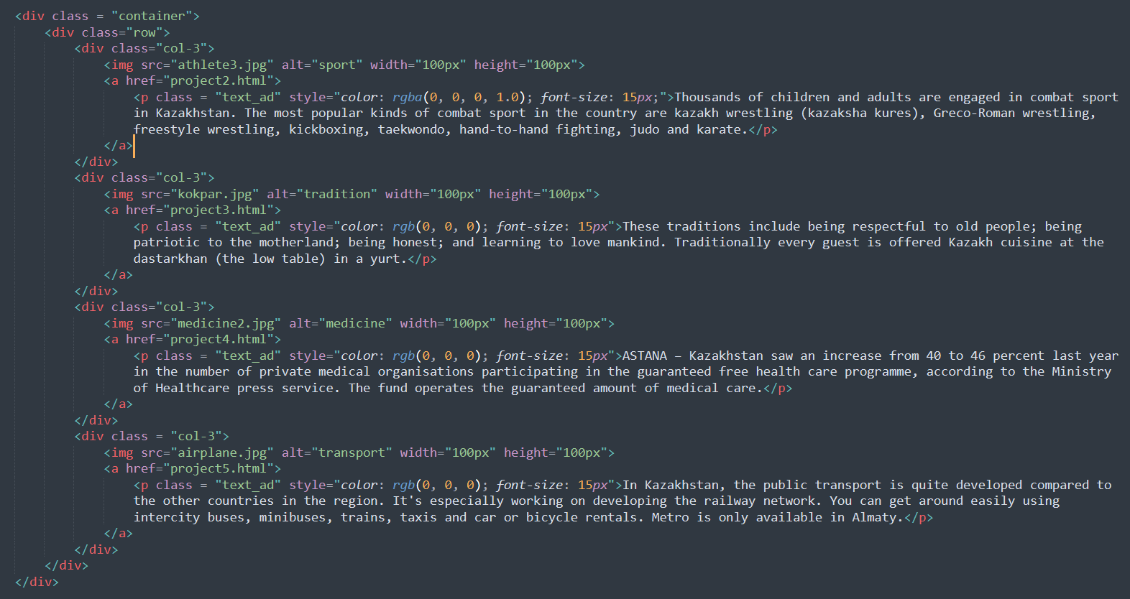

3)Some HTML elements in project must be aligned by bootstrap grid system.

Slide 6
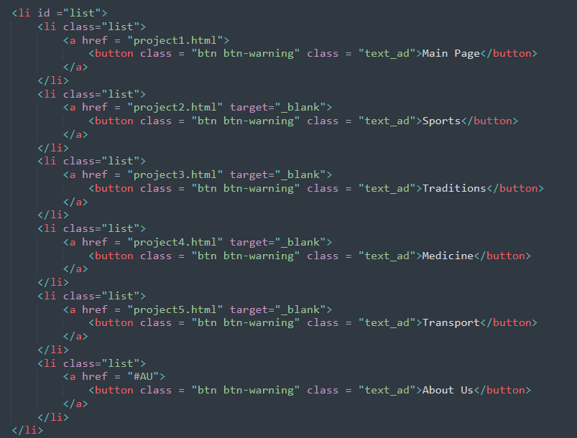
4)In your project you should have at least five buttons and two tables. They should have bootstrap classes.

Slide 7
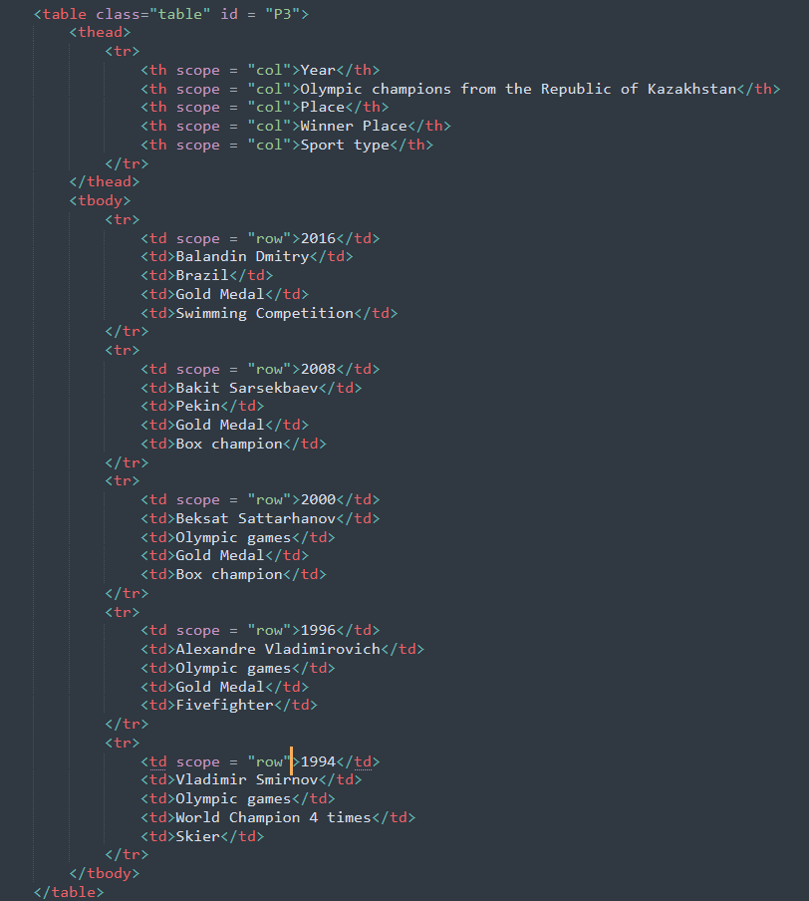
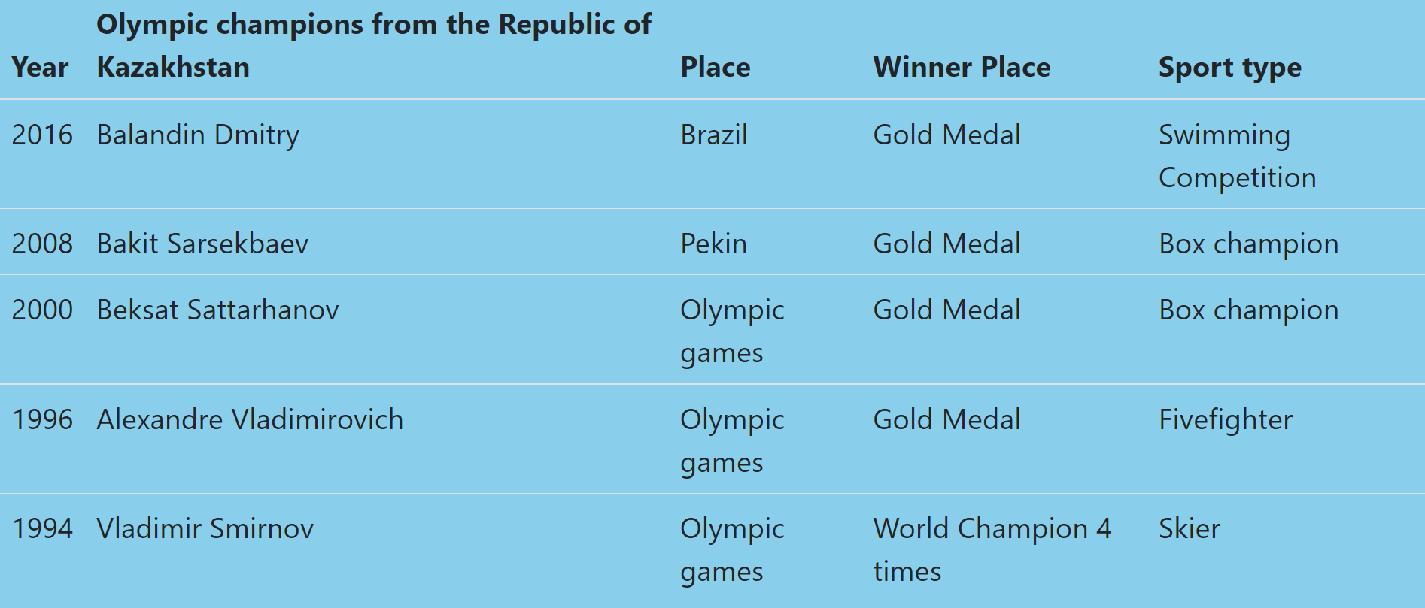
4)In your project you should have at least five buttons and two tables. They should have bootstrap classes.

Slide 8
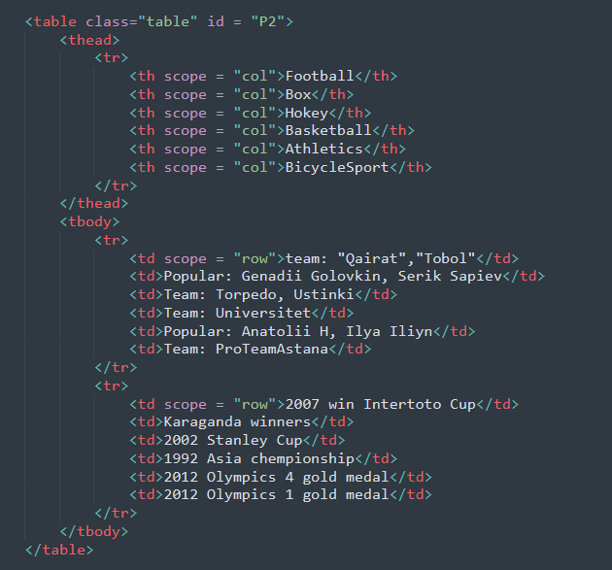
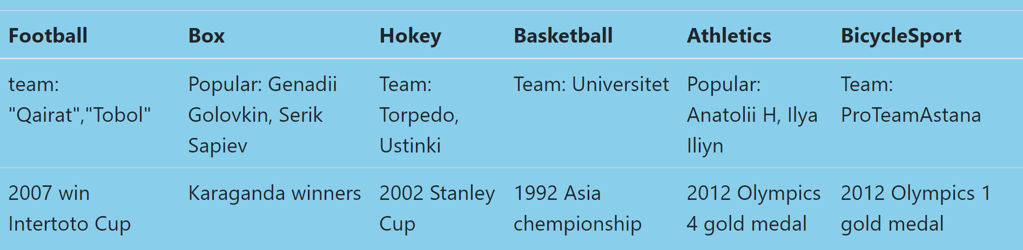
4)In your project you should have at least five buttons and two tables. They should have bootstrap classes.

Slide 9
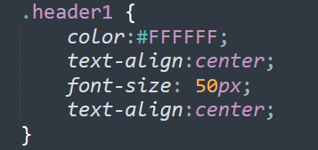
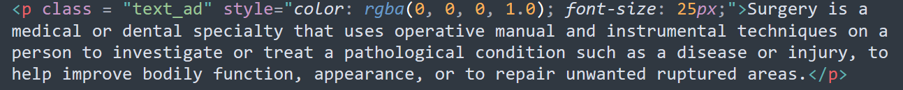

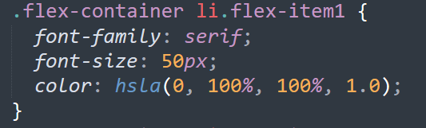
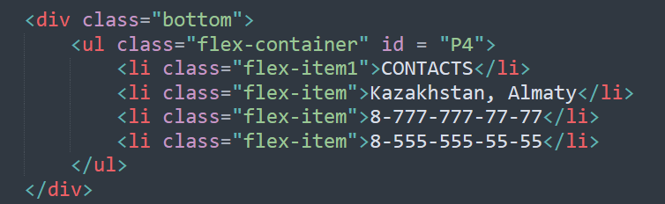
5)Colors should be defined by rgb, rgba, hsl, hsla functions and by hexadecimal numbers.

